Slide 1


Slide 2
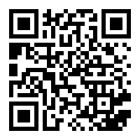
Urbit for the people...

Slide 3
Urbit is a system where everything works seamlessly
Urbit does not own your data - you own your Urbit
Urbit restores the original vision of the internet

Slide 4
Urbit is not a blockchain Urbit is not a cryptocurrency Urbit is not a magical time-warp machine (although…)

Slide 5


Slide 6
Urbit is a peer-to-peer internet being built from scratch to be more private, secure, and durable than the current internet.
A super-private computer, combined with an ID, which is
connected peer-to-peer with other Urbit computers.

Slide 7
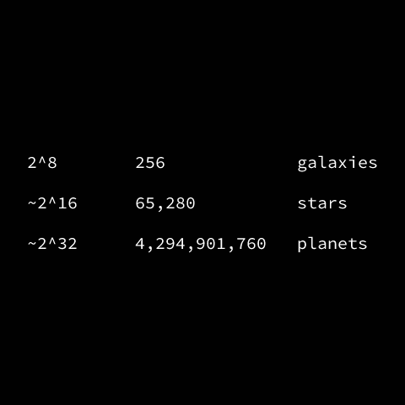
Urbit ID No intermediaries (centralized middle servers)

Slide 8
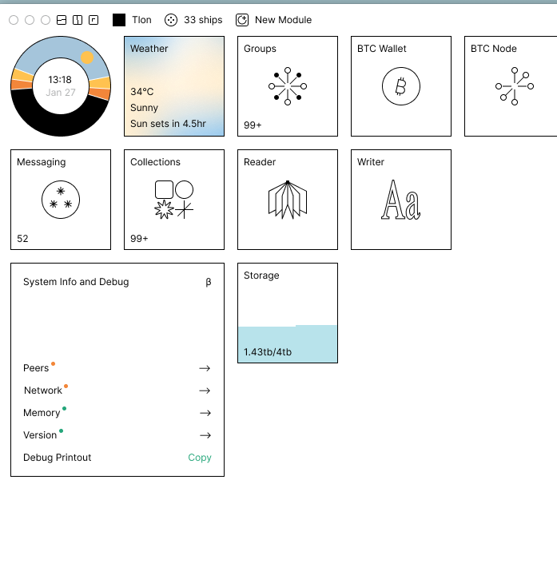
Urbit is minimalistic

Slide 9
The components:
A peer to peer network (direct communication)
You own server (computing happens on your server)
Permanent digital ID (decentralized ID, backed by code)

Slide 10
4. Incentive for good behaviour (scarcity)
5. Tools for people (50,000 lines of code)
6. Urbit is deterministic (efficiency)
7. Urbit is private (no tracking)

Slide 11
The killer feature of Urbit is… Urbit

Slide 12
Comparison:
Urbit vs Reddit (cookies)
Chat for discussions
Place for links & notes
Logins and security
Or use Urbit

Slide 13
Urbit vs Social Networks (you own the data)
Urbit vs Smart devices (you own the data)
Urbit vs Google Docs (you own the data)

Slide 14
Urbit bridge BTC Wrapper
Hoon 101

Slide 15
